Slide 1
A Tale of Two Clouds
Running an Application Across AWS and Azure
@_caseywatson

Slide 2
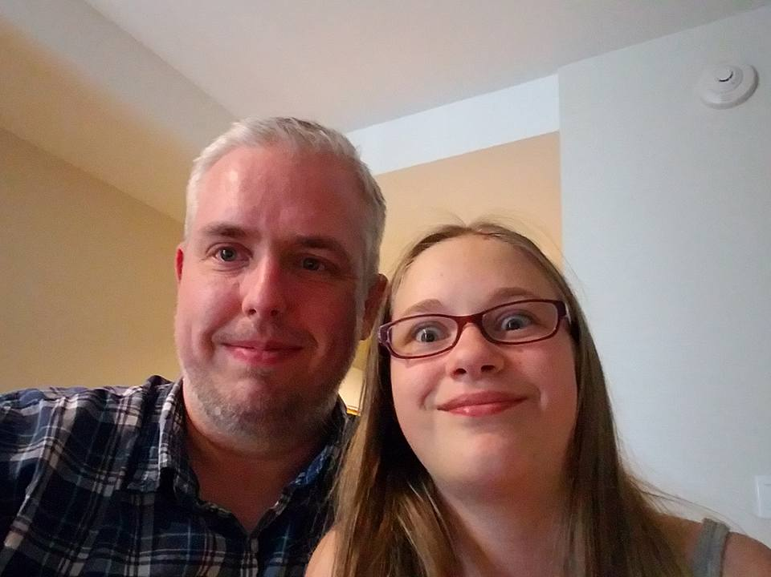

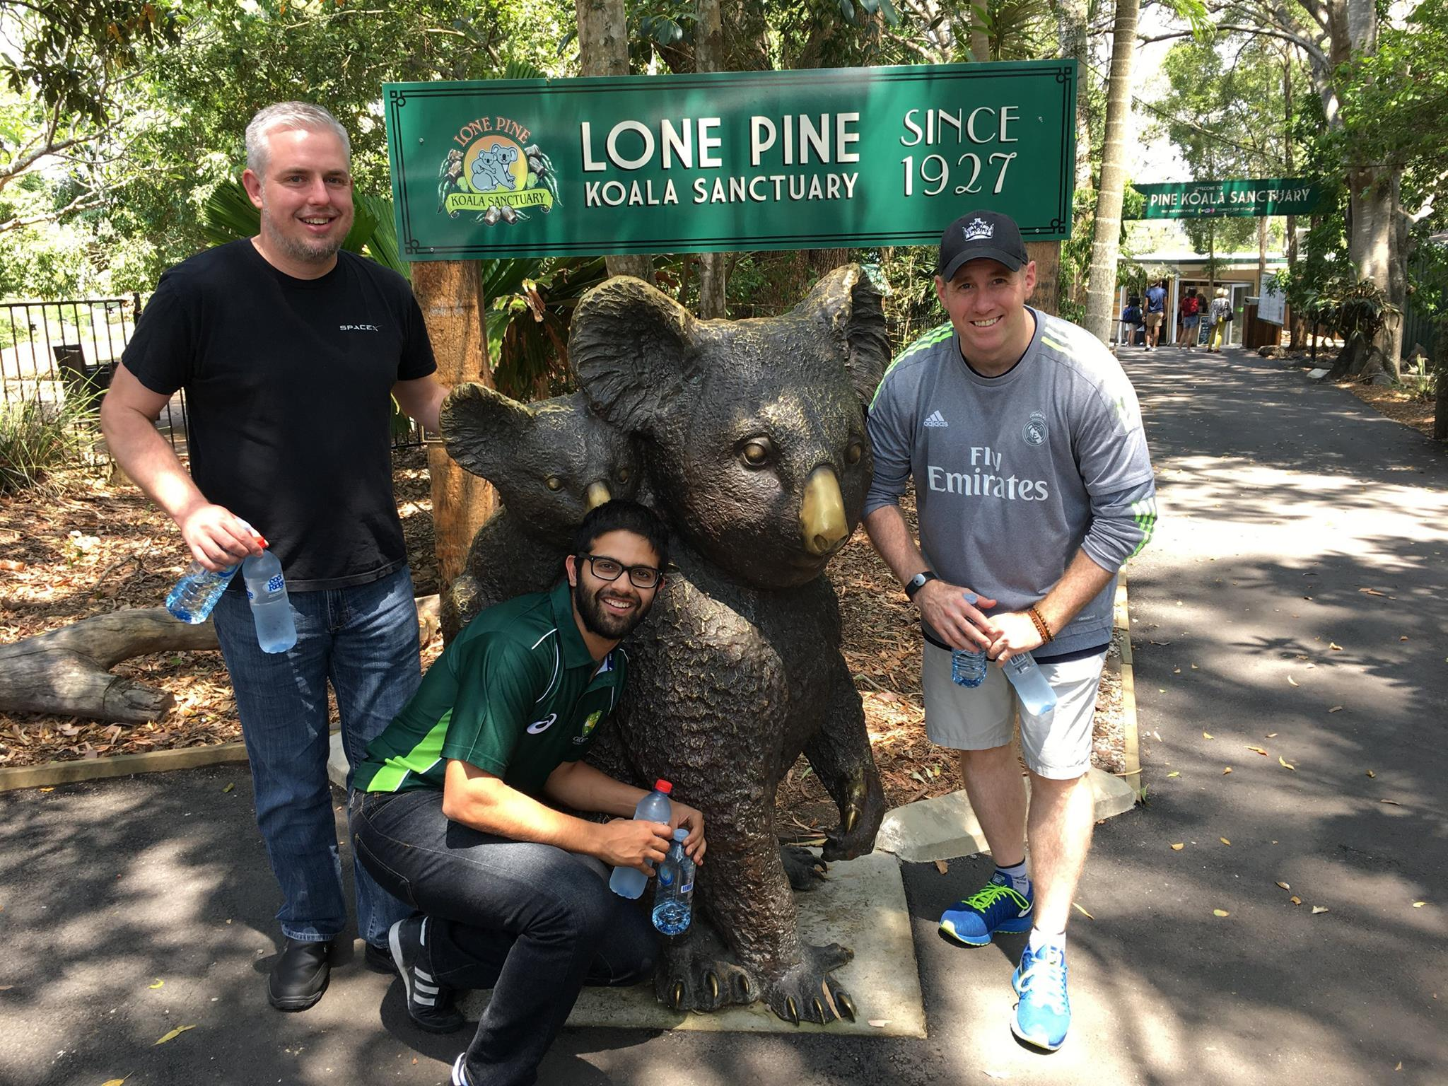
Hi! I’m Casey.
I live in Fort Worth, TX with my beautiful wife, daughter, three cats and one giant dog.
15 years of software development experience
Currently Senior Program Manager with the Azure Customer Advisory Team (AzureCAT) at Microsoft
I travel. A lot.
Avid enjoyer of whiskey

Slide 3
Why design for cloud portability?
Improved High Availability/Disaster Recovery (HA/DR)
Cloud consumers want to know that they have options
Promotes testability and cleaner architecture
Future-proofing
Compliance and regulations

Slide 4
Introducing the Multi-Cloud File Sharing App

Slide 5
Multi-Cloud File Sharing App Requirements
Basic web application that allows users to anonymously upload and download files
Geo-distributed deployment
Multiple cloud platforms
Native PaaS
Shared code base (where possible)
Minimal cost
Curveball: .NET + Node.js!

Slide 6
Multi-Cloud File Sharing App Design Considerations
Eventual consistency, strong consistency, or both?
How do we scale to handle unexpected spikes in traffic?
How do we ensure that users have the smoothest possible experience regardless of where they are located?
How do we store the files?
How do we store photo metadata? Relational database? NoSQL?
Should we go Serverless?
How do we separate the application logic from the underlying cloud platform?
How do we control costs?

Slide 7
Notional Application Architecture
Web UI
Replication Relay
Get File Metadata API
Update File Metadata API
Outbound File Replication Topic
Replication Relay
File Store
File Metadata Store
File Replication Processor
Inbound File Replication Queue
Replicate File API
“Other Cloud”

Slide 8




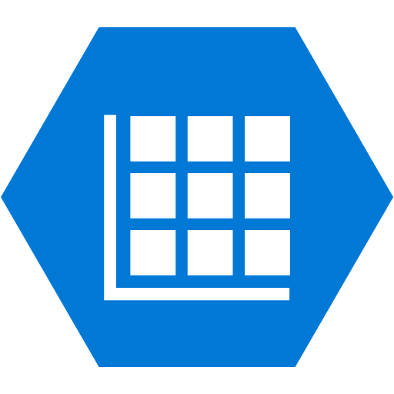


Azure Application Architecture
Web App
Replication Relay Function
Get File Metadata API Function
Update File Metadata API Function
Outbound File Replication Service Bus Topic
Replication Relay Function
File Blob Storage Container
File Metadata Storage Table
File Replication Processor Function
Inbound File Replication Service Bus Queue
Replicate File API Function
AWS

Slide 9






AWS Application Architecture
Elastic Beanstalk Web App
Replication Relay Function
Get File Metadata API Function
Update File Metadata API Function
Outbound File Replication SNS Topic
Replication Relay Function
File S3 Bucket
File Metadata DynamoDB Table
File Replication Processor Function
Inbound File Replication SNS Topic
Replicate File API Function
Azure

Slide 10







Global Application Architecture
Azure Traffic Manager
(Weighted Profile)
multicloudfilesharing.trafficmanager.net

Slide 11
Let’s take a look!

Slide 12
Try it out!
Go to multicloudfilesharing.trafficmanager.net and upload a file.

Slide 13
Key learnings
If DevOps is not part of your microservices story, you’re flying blind.
Cloud platforms are just different enough to make creating an abstraction layer difficult. Abstract features, not services.
Node.js isn’t as scary as I thought it would be.
I really like Node modules/NPM.
Outside of the most basic functions, the Lambda development story kind of sucks.
Azure App Service for Linux (S1) is overprovisioned in the Azure West US region.

Slide 14
Thank you!
@_caseywatson

